Slide 1
Slow motion trial…
Each trial requires two responses
A timed response using S or D
Untimed response using 1 2 3

Slide 2
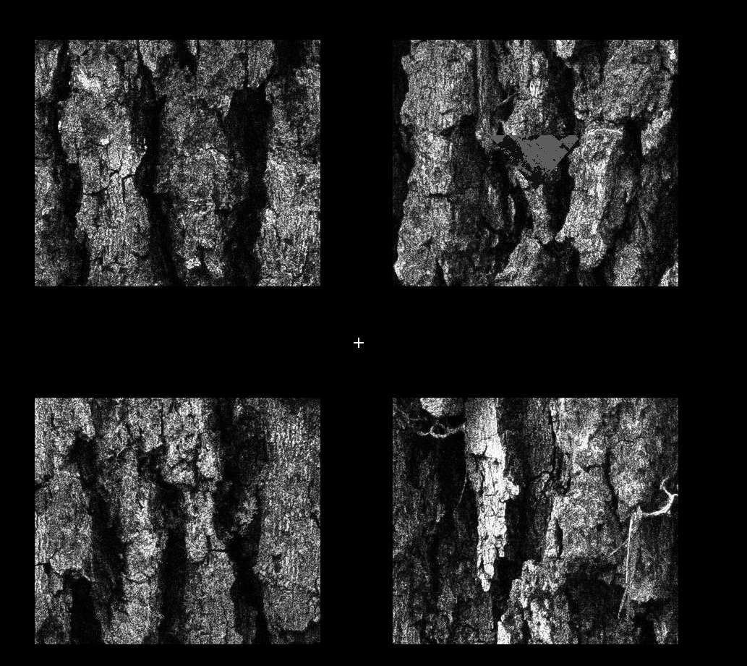

Slide 5
Respond S or D as soon as you see the grey triangle and decide on a match.

Slide 6
This isn’t a timed response, but don’t over think it, just give you gut feeling response on this screen.
Guessed Fairly Sure Certain
1 2 3

Slide 11
Guessed Fairly Sure Certain
1 2 3

Slide 12
Keep you right hand on the S and D keys and your left on the numbers.
Movement in the EEG causes a lot of data noise, so keeping your fingers on the keys stops you looking down/ moving you head.
Blinking also causes noise, try to time your blinks for when you’re making the certainty decision, and not during the presentation of the camouflage triangle. This will make it more likely you see it also!
Although it’s tempting to look directly at the squares, keep your eyes on the fixation cross at all times!

